Slide 1
SMARTPHONE ADDICTION

Slide 2
AIM OF OUR PROJECT
This project aims to examine how smartphone addiction affects the mental health and academic performance of college students.
OBJECTIVE
The objective of this project is to explore and analyze the phenomenon of smartphone addiction, its impact on individuals, and its relationship with mental health. The project aims to examine the causes and effects of smartphone addiction, identify the risk factors associated with it, and propose effective strategies for preventing and managing smartphone addiction. The project also aims to raise awareness about the negative consequences of smartphone addiction and promote healthy smartphone use habits among individuals. Ultimately, the project seeks to contribute to the development of a better understanding of smartphone addiction and its impact on individuals, society, and mental health.

Slide 3
INTRODUCTION
Smartphones are very important in college because they give students easy access to online information, sharing files, and communicating with others. But, many college students mainly use their phones for things like social media, watching videos, browsing the internet, and playing games instead of for college work. This can make it hard to learn and do well in class.
One problem with using smartphones too much is addiction. This means that someone can't control how much they use their phone and it can cause problems with their health and relationships. Addiction can make people feel anxious, lonely, and depressed. It can also lead to behaviors that are not good for a person's well-being.

Slide 4
METHODOLOGY
We conducted this survey among college students. We made a questionnaire consisting of around 24 questions to collect data of them using smartphones and it’s affect on their mental health as well as academic performance.
Our questionnaire consist of three sections:
Smartphone Usage (7 Questions)
Mental Health (10 Questions)
Academic Performance (8 Questions)
We have done reliability test of our questions of each section using Cronbach’s Alpha.
Cronbach's alpha is a measure of internal consistency, reliability, and homogeneity of a psychometric test or questionnaire. It is used to evaluate the extent to which items in a test are measuring the same underlying construct or dimension.

Slide 5
RELIABILITY TEST (USING CRONBACH’S ALPHA)
Cronbach’s Alpha score of smartphone usage questions section = 0.64
Cronbach’s Alpha score of mental health questions section = 0.723
Cronbach’s Alpha score of academic performance questions section =0.49

Slide 6
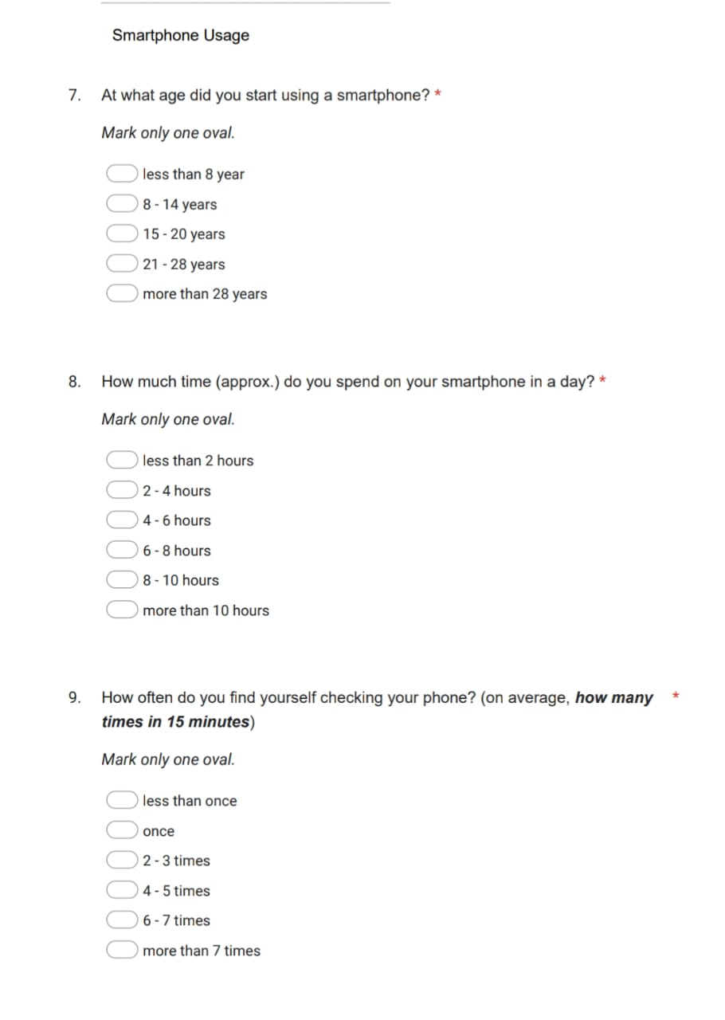
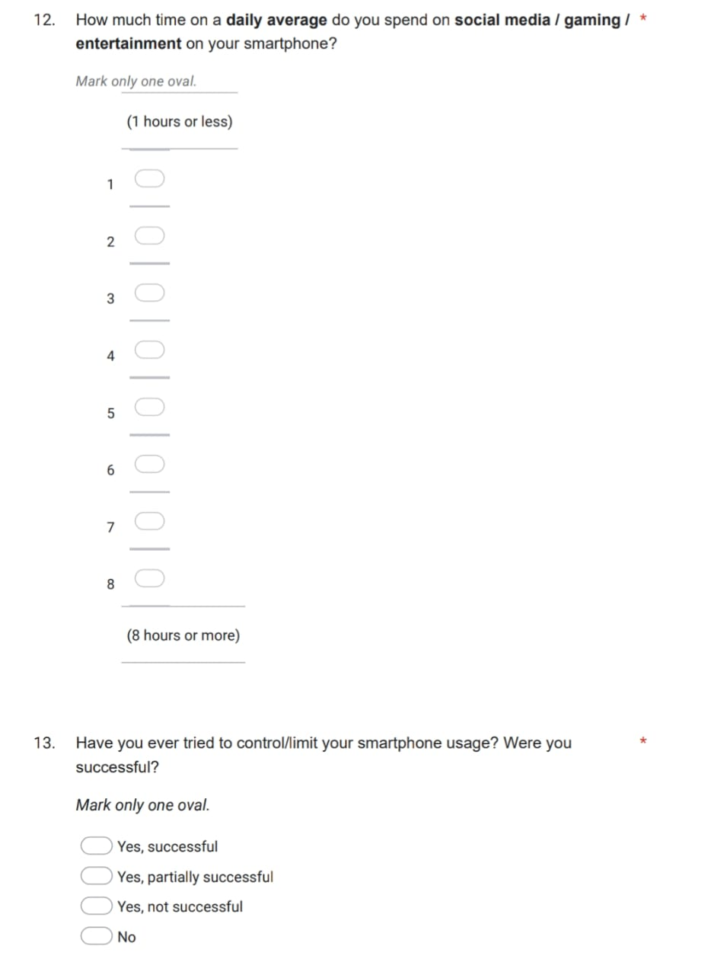
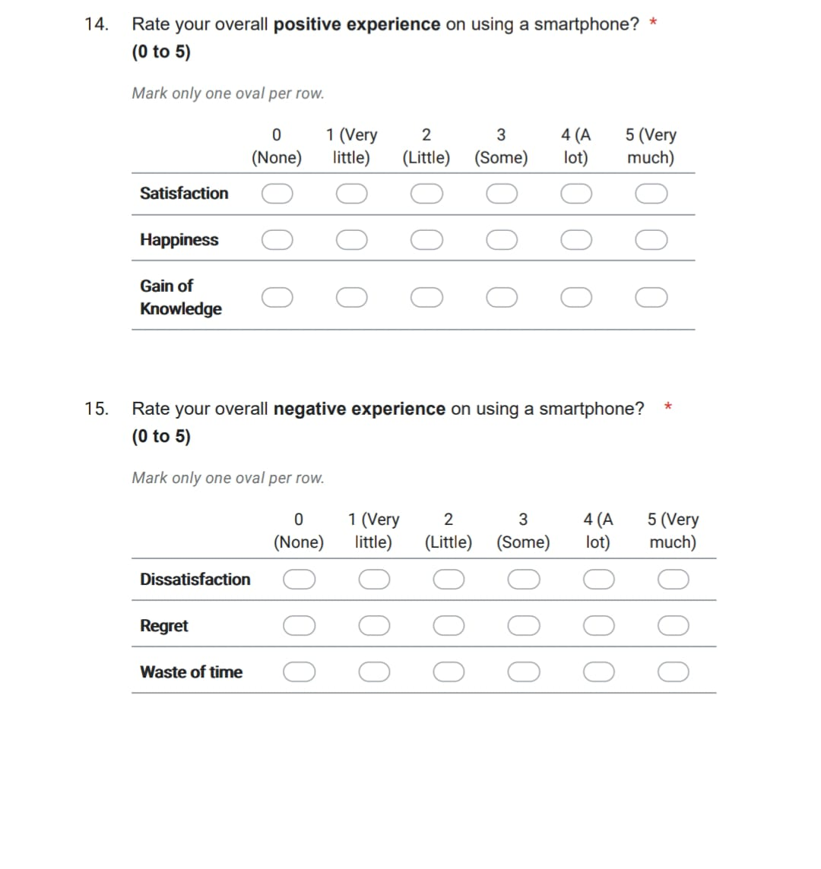

Slide 7
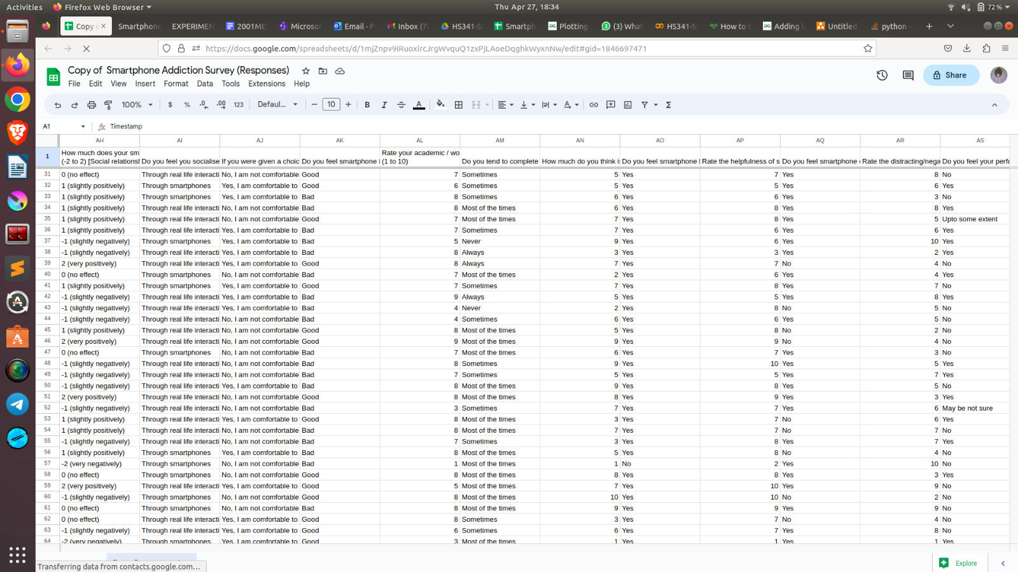
Demographic of our Data:
Total number of participants in this survey was 320.
We were able to collect data from 50+ different colleges.

Slide 8
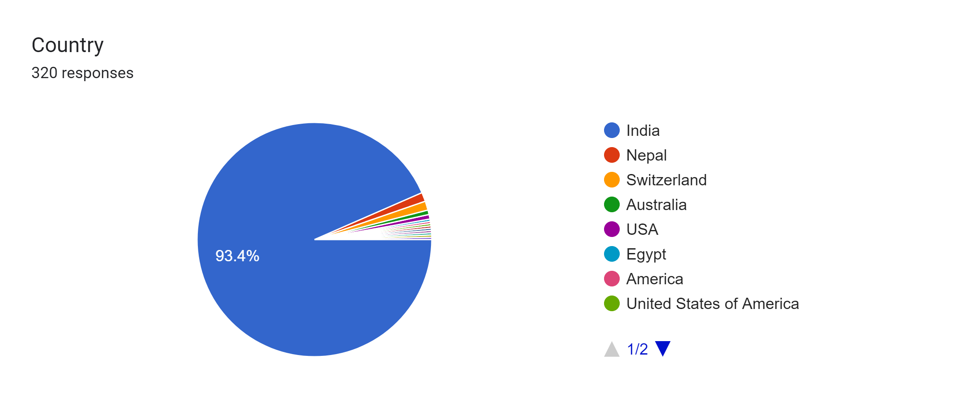
Country-wise Participant Distribution
Country | No. Of Participants
India | 299
Other (USA, Switzerland, Australia, Egypt, France, South Africa, Iceland, Nepal) | 21

Slide 9
Age Group | No. Of Participants
17-19 years | 26
19-22 years | 211
22-25 years | 83
Maximum no. of participants belongs to 19-22 years age group, i.e., 211.
Gender | No. Of Participants
Male | 245
Female | 66
Other | 9

Slide 10
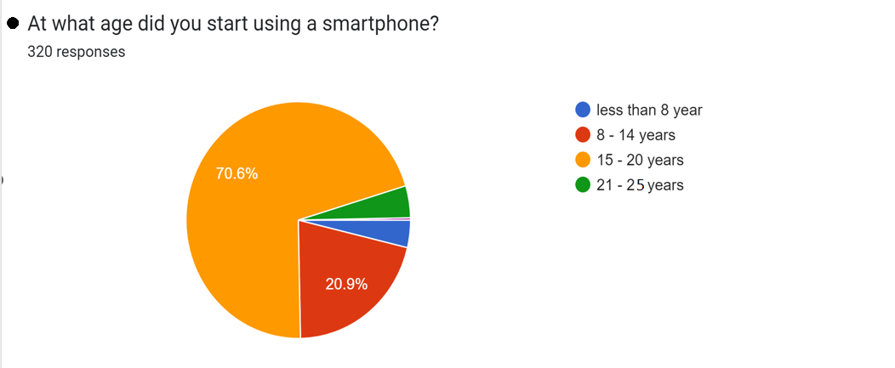
Age group of participants at which they started using smartphone | No. Of Participants
Less than 8 years | 12
8-14 years | 67
15-20 years | 226
21-25 years | 15

Slide 11
Time spent on smartphone per day | No. Of Participation
less than 2 hours | 13
2 - 4 hours | 75
4 - 6 hours | 116
6 - 8 hours | 71
8 - 10 hours | 29
more than 10 hours | 16
Frequency of checking phone in 15 min. | No. Of Participation
less than once | 52
once | 60
2 - 3 times | 106
4 - 5 times | 49
6 - 7 times | 14
more than 7 times | 39

Slide 12
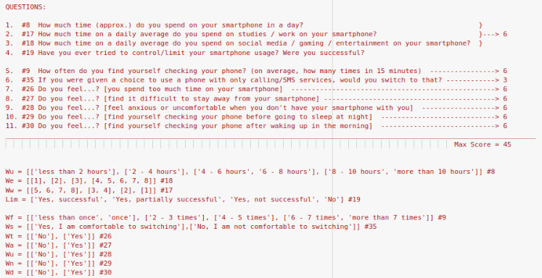
SECTION 1: SMARTPHONE USAGE

Slide 13
SMARTPHONE ADDICTION FORMULA
To determine smartphone addiction, we took seven questions from smartphone usage section of our survey questionnaire.
The responses of these questions varied from 0 to 6 on a Likert scale.
We also had questions regarding to the average time of smartphone usage, and the times spent on productive as well as non productive activities.
We also included the question about “Attempts at limiting your smartphone usage” into our smartphone usage formula as failed attempts might indicate smartphone addiction.
Also there might be cases where the person has high smartphone use, but this might be because of their work requirement rather than smartphone addiction. So, if the person has not even attempted to limit their smartphone usage, it might be because of work purposes.
So, keeping these considerations in mind, we devised a formula to include the responses of these questions into our 0 to 6 scale showing smartphone addiction :
Divided the usage times into two groups : “low usage” and “high usage”
Created a decision tree : Total usage time 🡺 Non productive usage time 🡺 Productive usage time
Created final check on “attempt to limit smartphone usage”
Adding all final response values which we have scaled from 0 to 6, and then keeping the mean as a threshold value for smartphone addiction. (final Addiction Score ranges from 0 to 45)

Slide 14
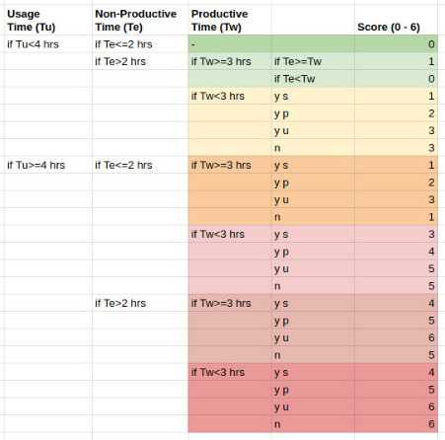
Overall score(0-6) for the 4 dependent Smartphone Usage questions

Slide 15
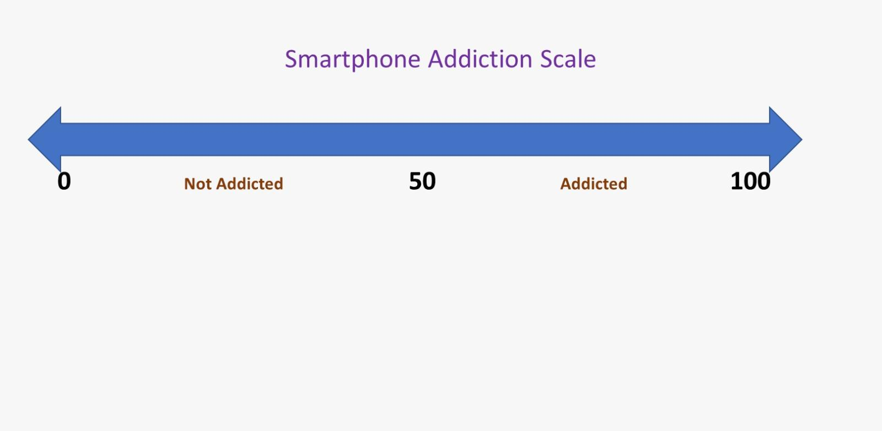
No. of participants having smartphone addiction = 233
No. of participants not having smartphone addiction = 87

Slide 16
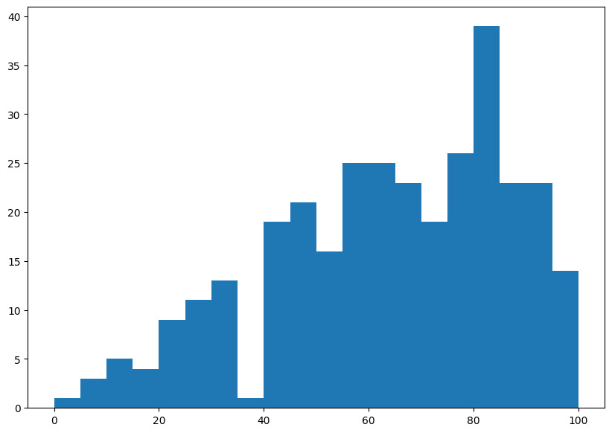
Frequency of responses vs Smartphone Addiction Score
Frequency
Smartphone Addiction Score

Slide 17
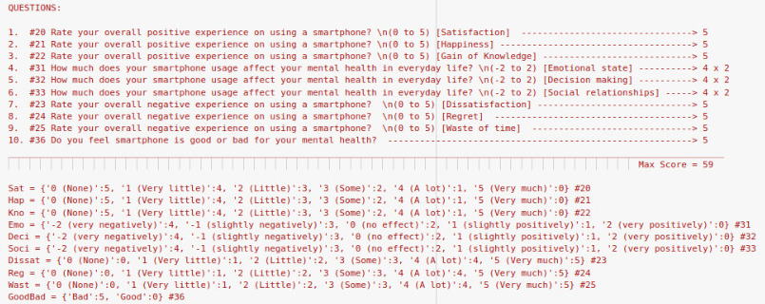
SECTION 2: MENTAL UNWELLNESS

Slide 18
MENTAL UNWELLNESS FORMULA
To determine mental unwellness, we took 6 questions from mental health section of our survey questionnaire.
The responses of this questions varied from 0 to 5 Likert scale.
For this section, we included questions like their positive experience, negative experience on using smartphone.
We also included questions about, how smartphone is affecting their mental health on everyday usage.
Also, question regarding their own opinion on their mental health getting affected by using smartphone was included.
For positive experience question as well as for the question how smartphone usage is affecting their everyday life, the score for the people who marked 0 rating are taken as maximum score, i.e, 5, as this is indicating that their mental health is not getting affected due to smartphone usage.
And for the question regarding their opinion on using smartphone, 0 is given for good and 5 is given for bad.
Now for calculating the mental health score, we have given more weightage to the question “How much does their smartphone usage affect their everyday life” as compared to other questions.

Slide 19
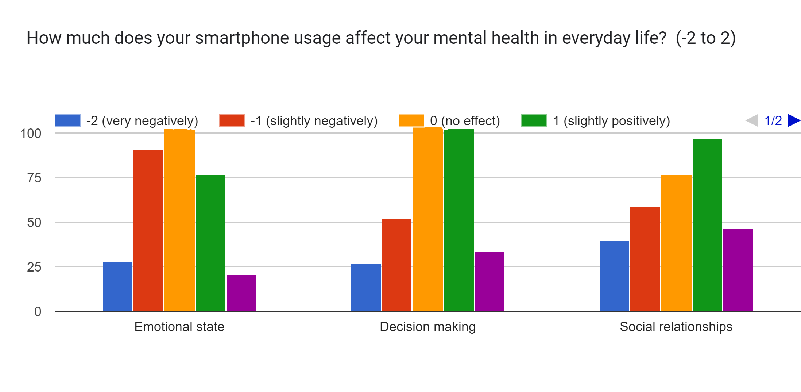
Affect of smartphone usage on mental health
These are the data which shows how smartphone affects on a person’s emotional state, decision making and social relationship. That’s why we gave more weightage to this question in our formula.

Slide 20
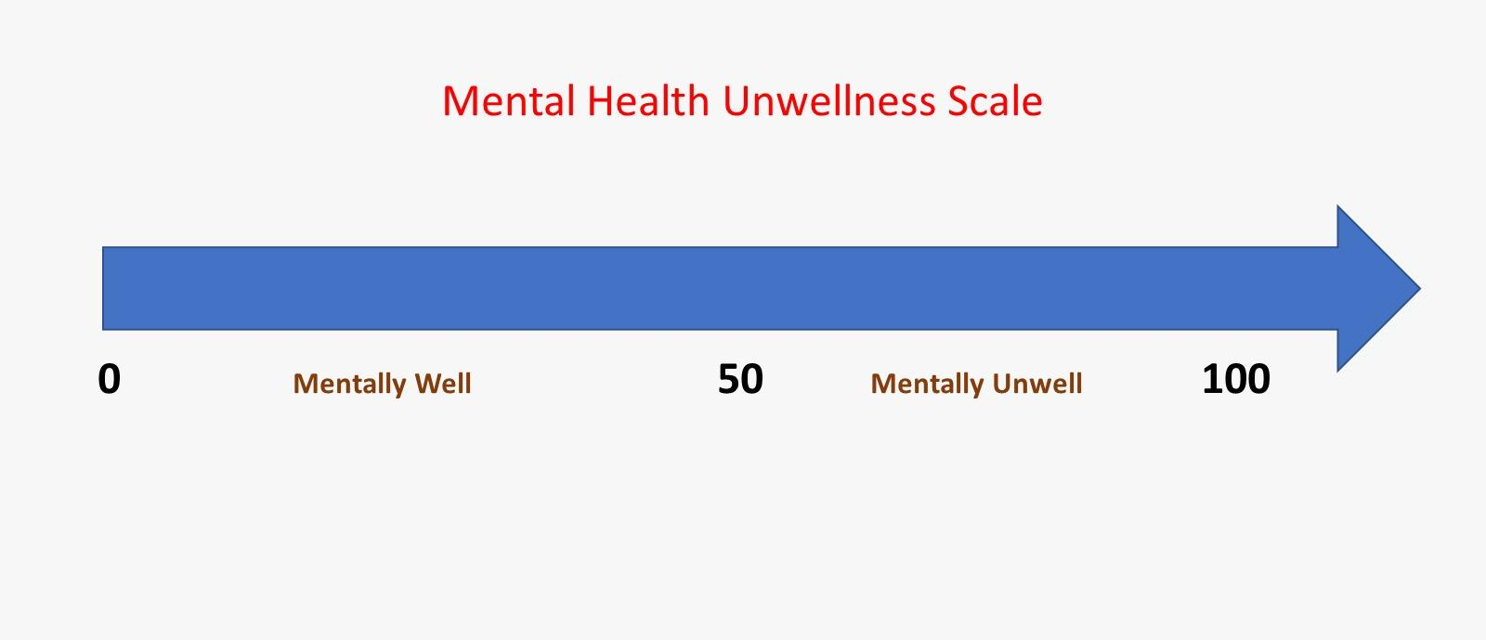
For calculating the mental health score we have generated a formula as shown below:
Mental Health Score = Satisfaction + happiness + gain of knowledge + (emotional state + decision making + social relationship) * 2 + good/bad feeling + dissatisfaction + regret + waste of time.
No. of participants who have poor mental health = 134
No. of participants who have good mental health = 186

Slide 21
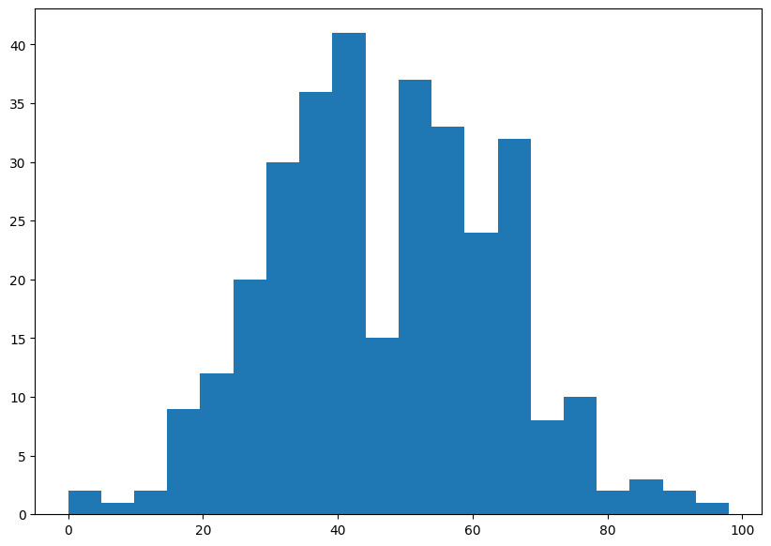
Frequency of responses vs Mental Unwellness Score
Frequency
Mental Unwellness Score
This graph is showing number of responses lying in that specific score range.

Slide 22
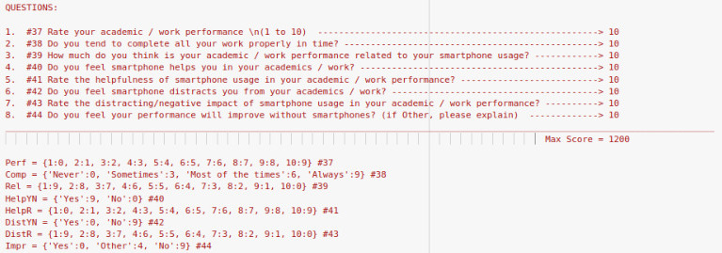
SECTION 3: ACADEMIC PERFORMANCE

Slide 23
ACADEMIC PERFORMANCE FORMULA
To measure academic performance, we have taken 8 questions from academic/work performance section.
The responses of this questions varied from 0 to 9 Likert scale.
For this section, we included questions for rating their academic performance.
We included questions, do they complete all their work properly or not and how smartphone usage is affecting this.
We also included questions on how much their academic performance is related to their smartphone usage.
Also questions on how their academic performance was affected by using their smartphones, and if it helped or distracted them were included.
We also asked them if their performance will improve or not without smartphone.

Slide 24
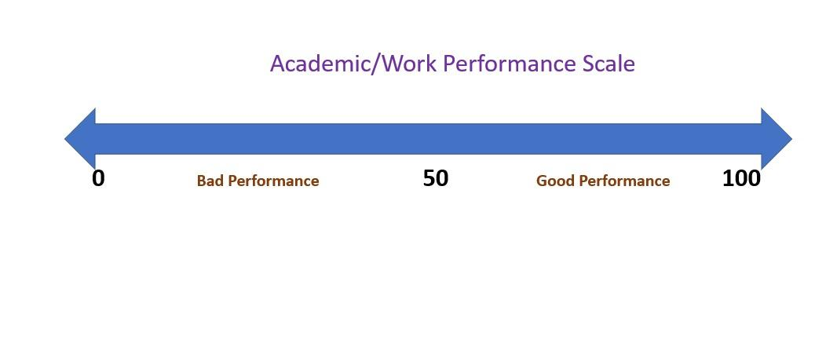
For scoring part, we have given points 0 to 9 for all the questions.
For question, if they tend to complete their work in time or not, point 9 is for always and 0 is for never.
Regarding question for helpfulness, point 9 is given to very helpful and point 0 is for not helpful.
And for question regarding distraction, point 9 is for not distracting and point 0 is for very distracting.
By using above scoring methods, we have made a formula for calculating academic performance score
Academic performance score = (Q1 + Q2)*(Q3 + Q4 + Q5 + Q6 + Q7 + Q8).
No. of participants having good academic performance = 64
No. of participants having bad academic performance = 256

Slide 25
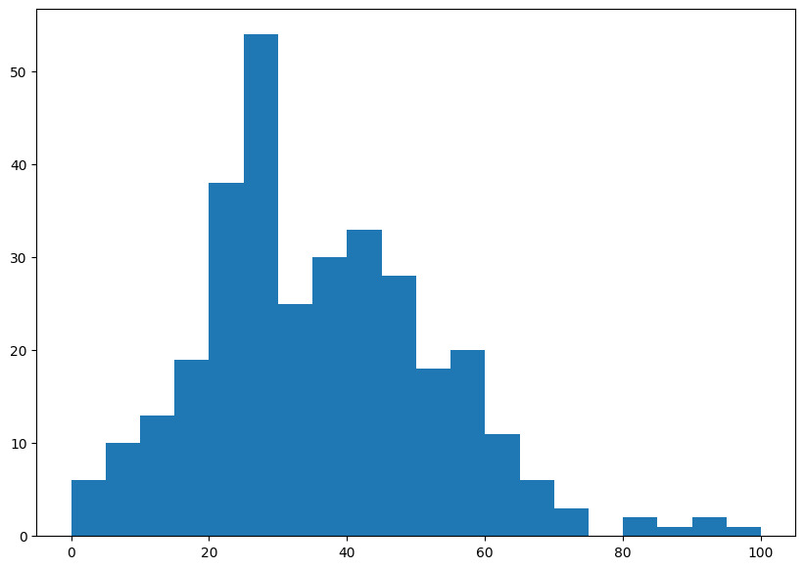
Frequency of responses vs Academic Performance Score
Frequency
Academic Performance Score

Slide 26
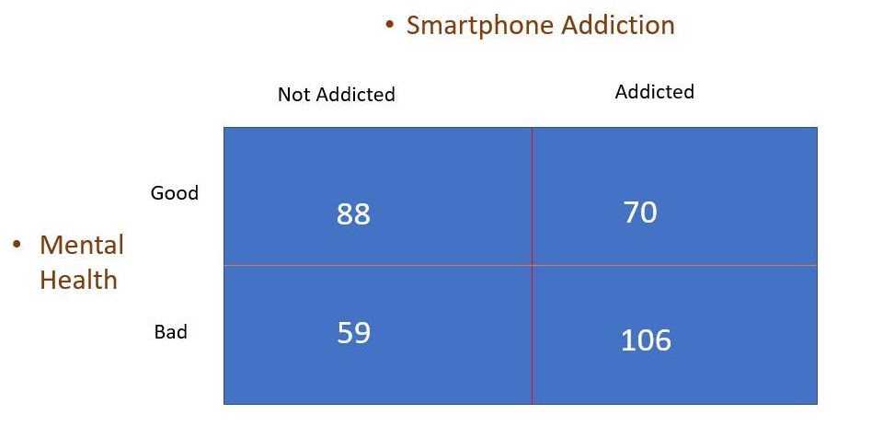
RESULT
Relationship between Mental Health and Smartphone Addiction
This data table shows people who are addicted have bad mental health and people who are not addicted tend to have good mental health.

Slide 27
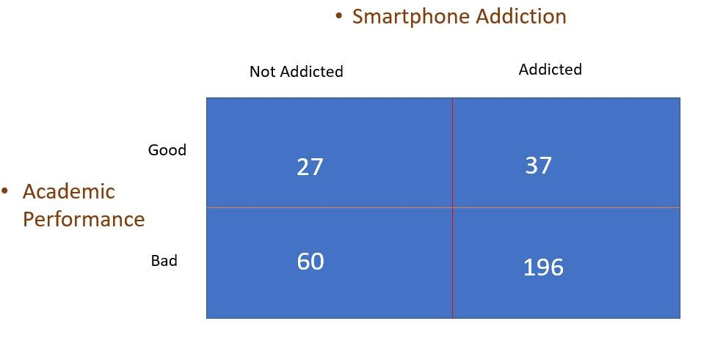
Relationship between Academic Performance and Smartphone Addiction
This data table shows that no. of people who are addicted having bad academic performance is very high, i.e, 196.

Slide 28
Non-addicted Peoples
Average mental unwellness score = 49.92
Average academic performance = 43.03
Addicted Peoples
Average mental unwellness score = 48.45
Average academic performance score = 32.80
We analysed our whole data using Python programming language.
We used the library Pandas, Matplotlib for data visualization

Slide 29
CONCLUSION
We found that people who have smartphone addiction have poor mental health as compared to non-addicted people.
We also found that those who have smartphone addiction also have poorer academic performance.
Hence our survey was successful in collecting data and finding the direct correlation of smartphone addiction to mental health and work performance.
References:
https://www.amhsr.org/articles/innovation-a-hypothesis-introduce-a-formula-for-calculation-of-human-health.pdf
https://www.ncbi.nlm.nih.gov/pmc/articles/PMC3877074/

Slide 30
Some suggestions we got from participants:
Spending time with parents and siblings, grandparents or comic books 📚 sometimes visit relatives home. Go out with friends visit parks proper routine.
“My phone has only 2 GB ram, so I don't install social media and shopping apps, otherwise the phone starts running slow. That's why I do very little on social media.”
“Turn off app notification sounds. Turn off notifications on lock screen. Keep distracting apps away from home page”

Slide 31
THANK YOU
Group Members:
Balajee (2001ME13)
Chandra Prakash Sah (2001ME15)
Pranav Raj (2001ME47)
Priyanshu Patra (2001ME55)
Pushpanjay (2001ME57)
Sanskar Singh (2001ME66)
Rahul Kumar (2001EE50)

